Slide 1
Git, GitHub, R Projects, ggplot2
and generally how to keep sane while coding

Slide 2
Setting up Git and GitHub
Great Tutorial @ Happy Git with R: http://happygitwithr.com/
Why use Git & GitHub?
It acts as a ‘Track Changes’ for your code
Provides a central location to store all files related to a project
Allows for easy collaboration with multiple people (who might be coding different parts of the analysis)

Slide 3
Important!
If you are a student, you should apply for a GitHub student developer pack here:
https://help.github.com/articles/applying-for-a-student-developer-pack/
This will give you the opportunity to make unlimited private repositories

Slide 4
Setting up Git/GitHub
First steps…
Create a GitHub account
Install or upgrade R and Rstudio
Install Git
Before installing Git, check whether it is already installed on your computer

Slide 5
Confused about Git?!
Installation Issues:
http://happygitwithr.com/install-git.html
Becoming Familiar with Git:
http://happygitwithr.com/hello-git.html

Slide 6
Connecting to GitHub (manually)
http://happygitwithr.com/push-pull-github.html
You can potentially skip this step, however, I think this helps you get acquainted with the process of creating repositories, making commits, and pushing and pulling to GitHub

Slide 7
Connecting RStudio to GitHub
Set up key for SSH: http://happygitwithr.com/ssh-keys.html
Create a new repository on GitHub
Clone the GitHub repository to your computer via Rstudio
Test out the local repository to make sure it works (commit, push, check GitHub to make sure changes propagated)
http://happygitwithr.com/rstudio-git-github.html

Slide 8
Collaborating with GitHub
Don’t overcomplicate things!
You don’t really need to fork/branch/merge if most of the analyses are done between only a handful of people
This is especially true if people aren’t working on coding the same thing simultaneously
Do communicate with your collaborators
Whether you communicate via email, or through GitHub (i.e. creating new issues, pull requests), it is a good idea to set up a clear communication scheme
This includes selecting one person as a designated conflict manager

Slide 9
R Projects
and general organization of code

Slide 10
R Projects
In short… a simple way to keep files associated with one project together
First things to ask yourself:
Where am I going to save my projects?
How am I going to organize my projects?
What does my typical workflow look like?

Slide 11

R Projects
Documents
Projects
Where am I going to save my projects?

Slide 12

R Projects
Documents
Projects
R_Users_CPS_Trawl
R_Users_CPS_Trawl.Rproj

Slide 13


R Projects
Documents
Projects
R_Users_CPS_Trawl.Rproj
R_Users_CPS_Trawl
Trawl_Analysis_6_FINAL.R
Fig_4_newcolors_fixed.pdf
Trawl_Analysis_FINAL_7.R
raw_data_cleaned.xlsx

Slide 14

R Projects (bad)
Documents
R_Users_CPS_Trawl.Rproj
Trawl_Analysis_6_FINAL.R
Projects
Fig_4_newcolors_fixed.pdf
Trawl_Analysis_FINAL_7.R
R_Users_CPS_Trawl
raw_data_cleaned.xlsx

Slide 15
What does your typical workflow look like?
Data Processing:
find missing values
sort/group data, re-label categories, format dates
generate a clean .Rdata file
Analysis:
code to generate mind-blowingly awesome science
Figures:
code to generate all figures

Slide 16

R Projects (better)
Documents
Projects
R_Users_CPS_Trawl.Rproj
R_Users_CPS_Trawl
Data
Output
Figures
data_processing.R
analysis.R
figures.R
R_Users_CPS_Trawl.Rmd

Slide 17
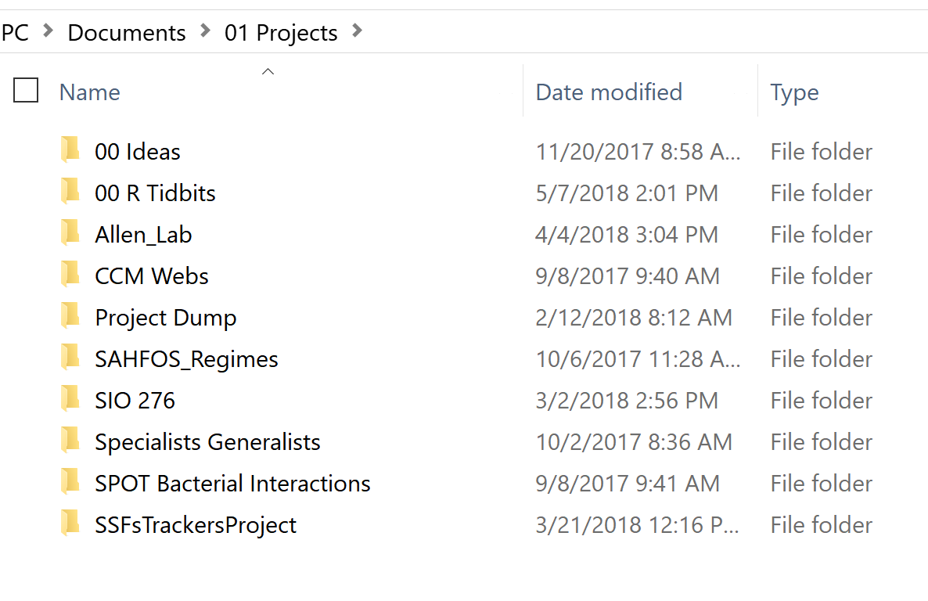
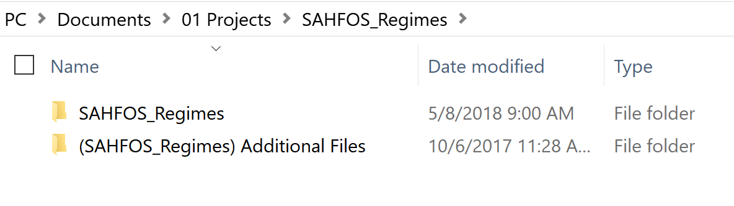
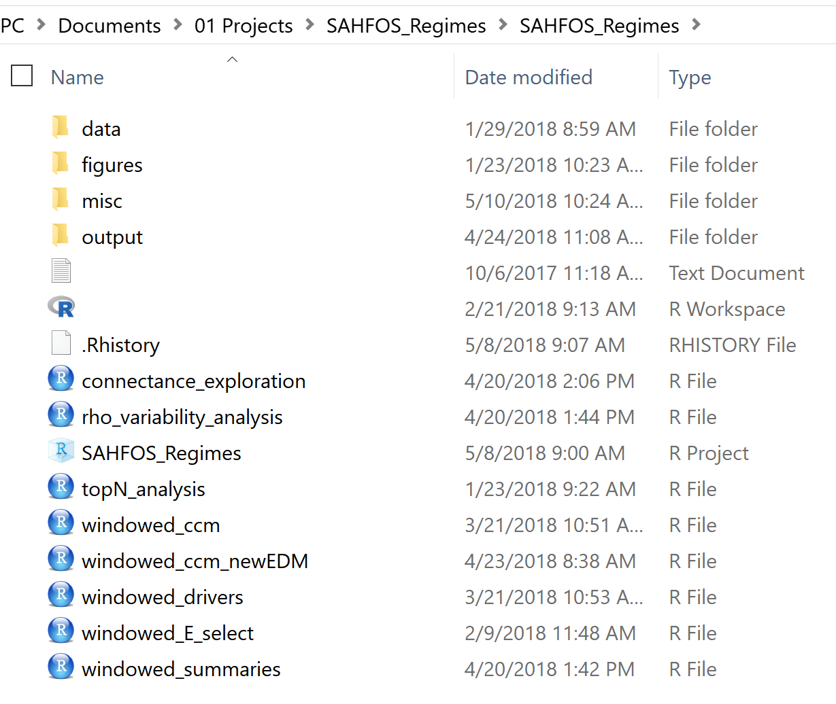
Realistic Organization (new project)

Slide 18
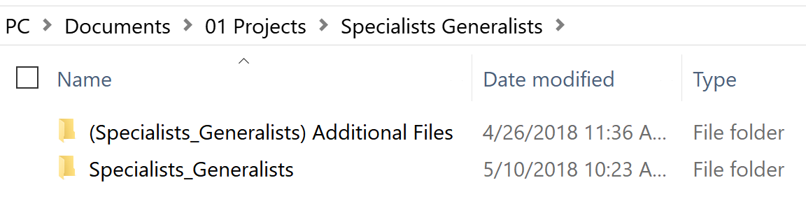
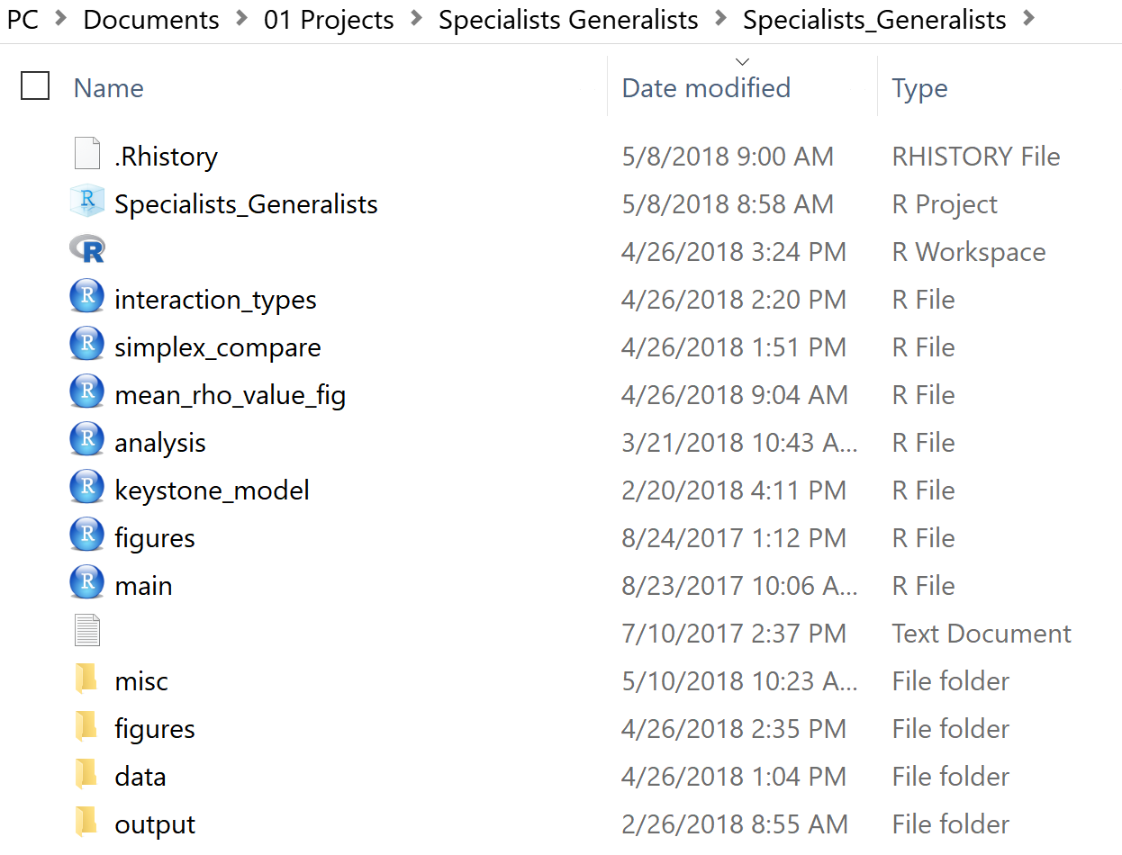
Realistic Organization (intermediate project)

Slide 19
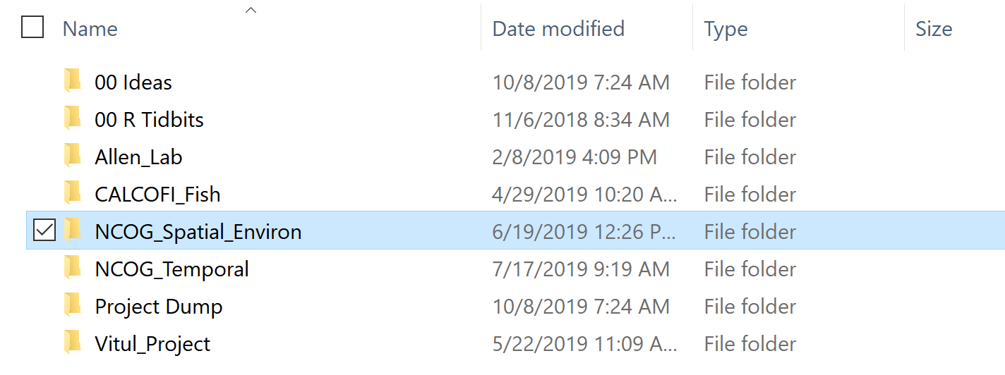
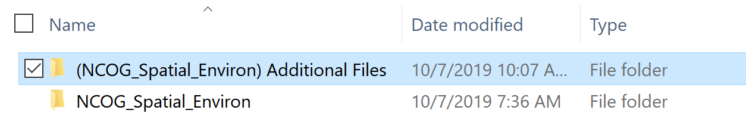
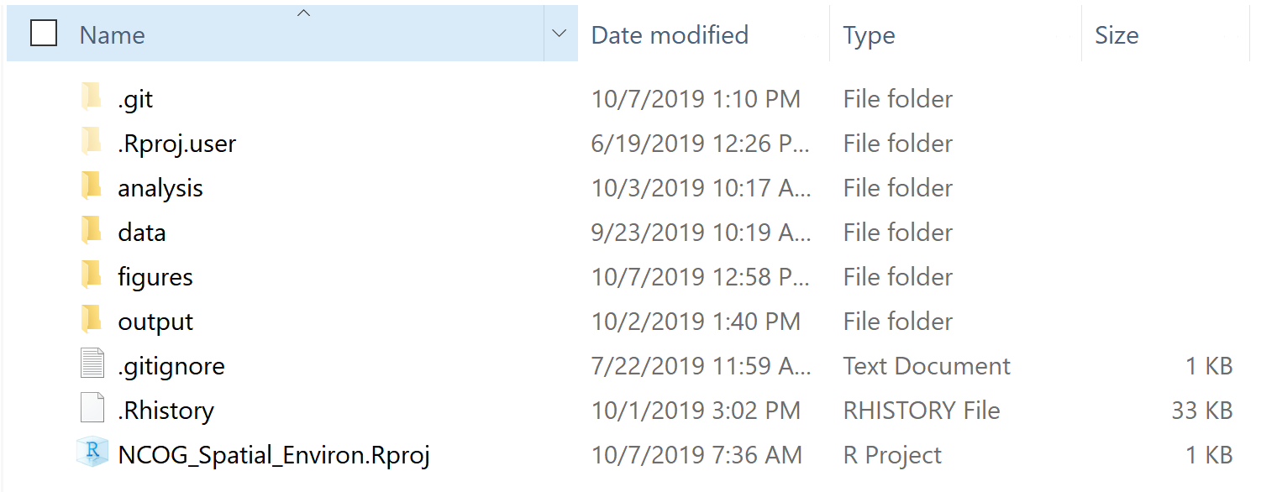
Realistic Organization (near finished project)

Slide 20
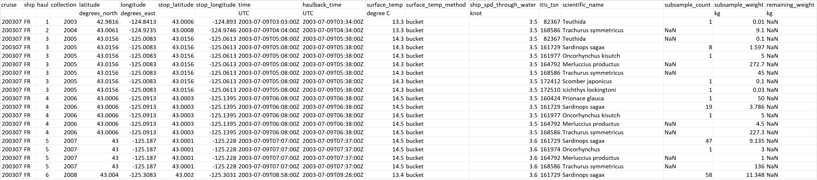
Data Processing Example

Slide 21
Data Processing Example
Data
Identification
Location
Data
Time
Data
Biological
Data
Environmental
Data

Slide 22
Data Processing Example
Data
Identification
Location
Data
Time
Data
Biological
Data
Environmental
Data
What does subsample count mean?
Subsample weight?
Remaining weight?
Notice there are often multiple rows per haul
(one per species identified)
Data_id = 200307_1
Date = 07-09-2003 5:08

Slide 23
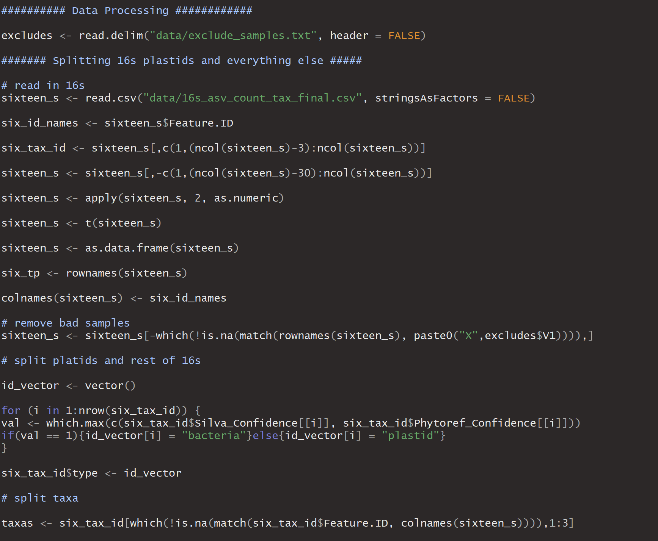
Data Processing Example

Slide 24
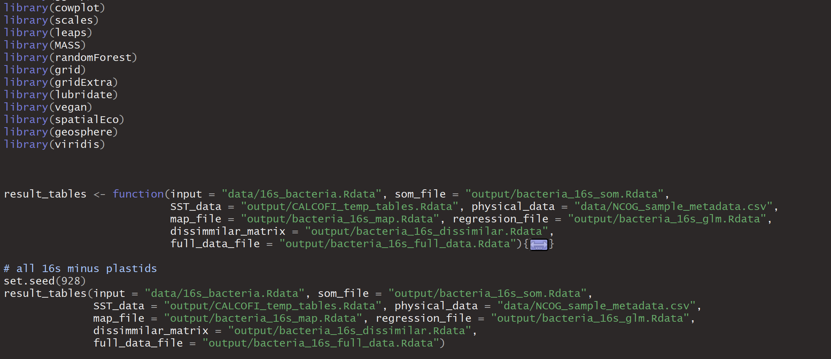
Analysis Example

Slide 25
Final Comments
Write code in a way that makes it accessible to collaborators (and your future self)
Make your code reproducible (functions make this easier)
Organize your code to match your workflow
If the project is simple, keep your organization simple

Slide 26
ggplot2

Slide 27

The way of the ggplot2
Think! What is your plot going to look like?
What is the format of your data?
How do you get your data into the correct format for ggplot?

Slide 28
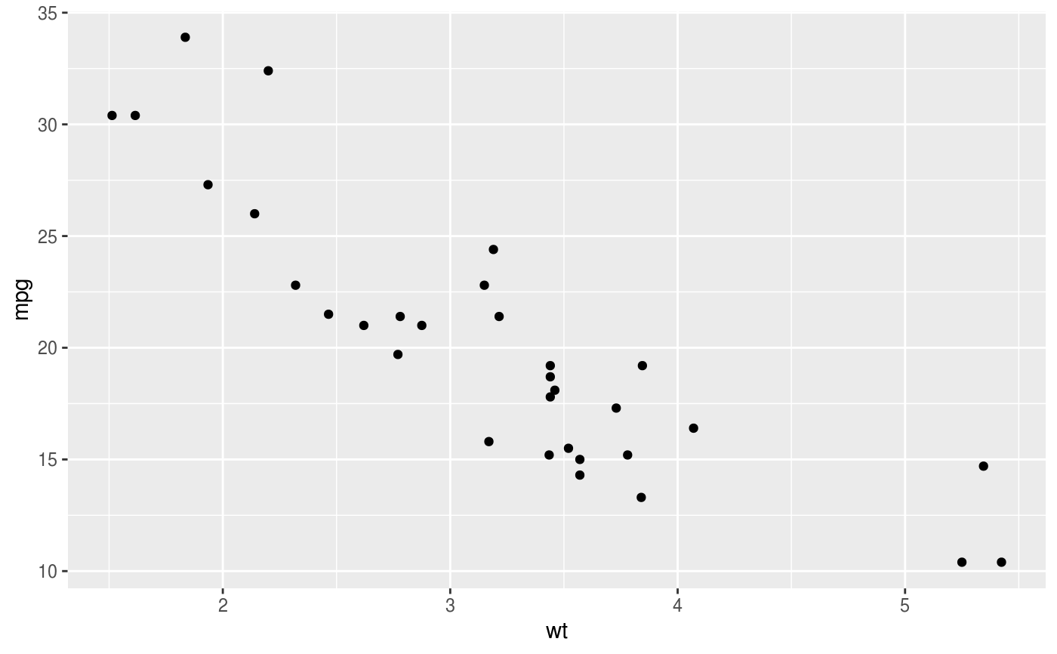
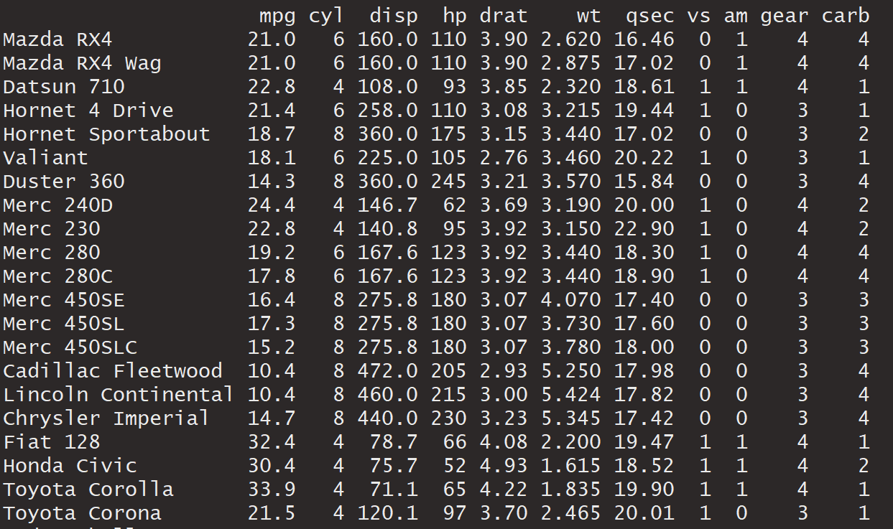
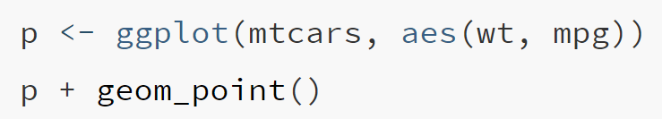
aes(x = wt, y = mpg,)
geom_point(color = “black”)

Slide 29
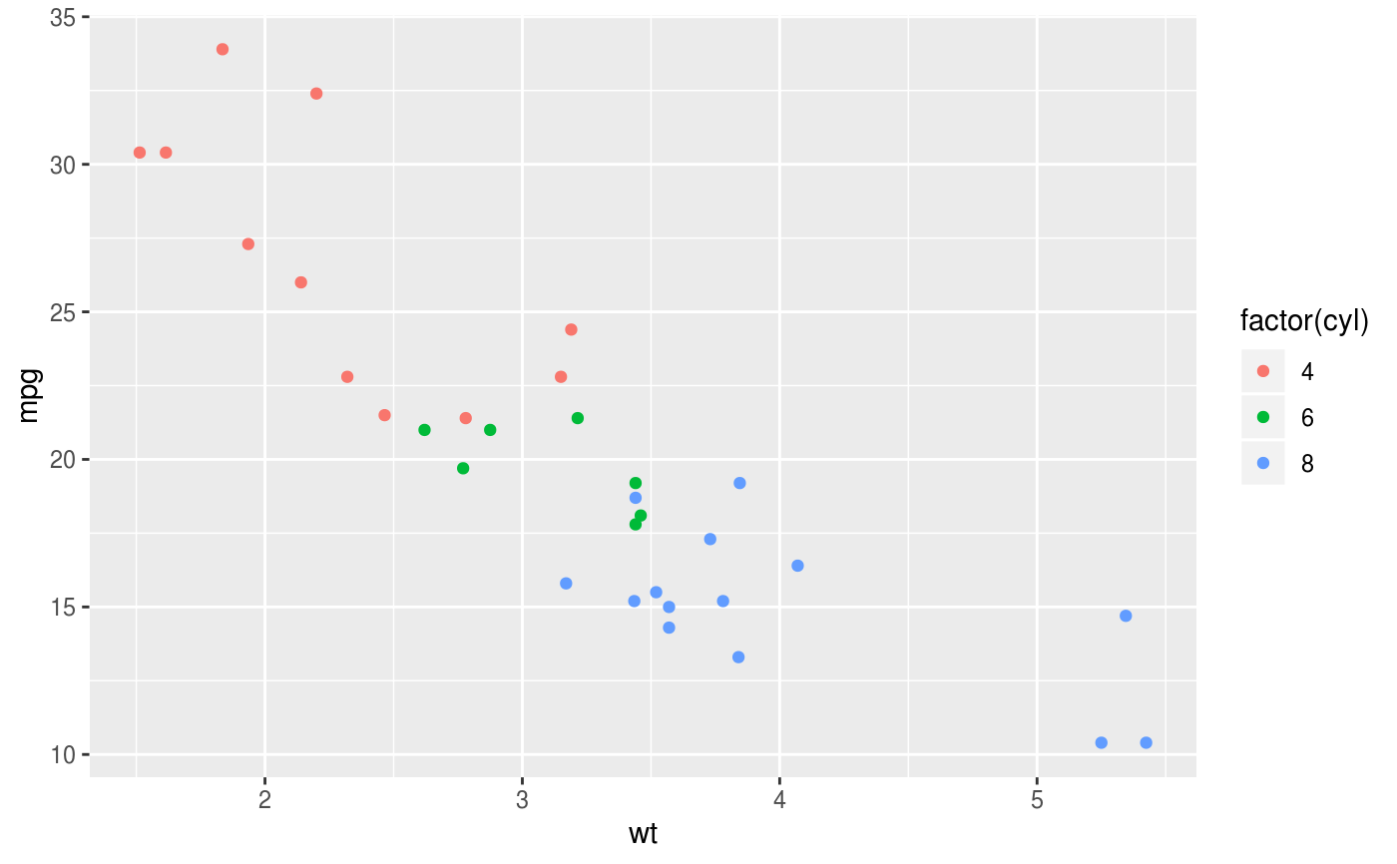

aes(x = wt, y = mpg, color = cyl)
geom_point()

Slide 31
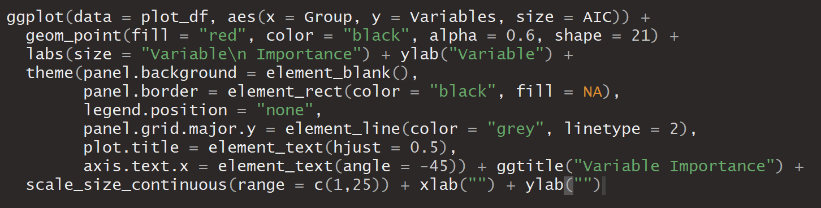

Slide 32
